Slide 1


Session 1: Introducing Multicultural Education

Slide 2
Do Now:
Take a few minutes to reflect on the following question. Then, write your response down.
What do you think of when you hear the term “multicultural education”?

Slide 3
Multicultural Education
Banks and Banks (1995) define multicultural education:
"Multicultural education is a field of study and an emerging discipline whose major aim is to create equal educational opportunities for students from diverse racial, ethnic, social-class, and cultural groups. One of its important goals is to help all students to acquire the knowledge, attitudes, and skills needed to function effectively in a pluralistic democratic society and to interact, negotiate, and communicate with peoples from diverse groups in order to create a civic and moral community that works for the common good." (p. xi)

Slide 4
Video “Session: 01”
As you watch the video, reflect on your own experiences with diversity in the classroom. How are your experiences similar? How are they different? When the video is over, take a few minutes to jot down your response.

Slide 5
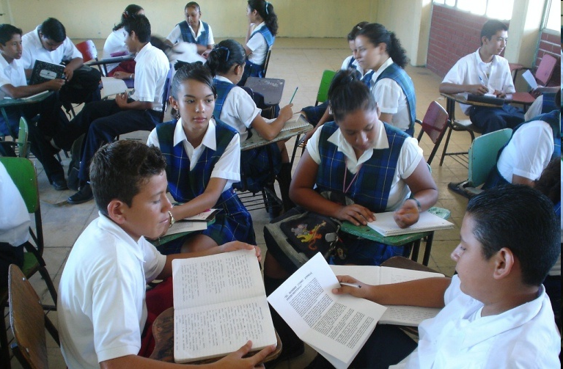
Activity
“Multicultural Education Overview”
Text Rendering (see hand out)

Slide 6
Text Rendering Debriefing
Discussion Questions:
What stood out to you as the most interesting? Why?
How does what you read in the article transfer into your classroom?
What do you think the educator’s role is in this process?

Slide 7

Exit Ticket:
Now, that you have a cleared understanding of what multicultural education really is, take a moment to answer the question from the Do Now once more.
What do you think of when you hear the term “multicultural education”?

Slide 8
References
Banks, J.A., & Banks, C.A.M. (Eds). (1995). Handbook of research on multicultural education. New York: Macmillan. Retrieved April 23, 2010, from http://www.ncrel.org/sdrs/areas/issues/educatrs/presrvce/pe3lk1.htm

